Slide 1
Capstone Project Hotel Booking Analysis - EDA
By – Suraj Senapati
(senapatisuraj13@gmail.com)

Slide 2
Table of contents
01
02
03
04
Agenda of Data Analysis
Hotel Booking Data-Introduction
Benefits for doing this Hotel Booking Analysis Project
Short introduction of the Dataset
Data Description & Summary
EDA (Exploratory Data Analysis)
Dataset Summary & Description of all the data
Data Visualization, Overall Stats and Conclusion

Slide 3
Agenda of Data Analysis
To discuss the analysis of given hotel bookings data set from 2015-2017.
We’ll be doing analysis of given data set in following ways :
Univariate Analysis
Bivariate Analysis
Hotel-wise Analysis
Room Type Analysis
Distribution Channel-wise Analysis
Meal Type Analysis
Booking Cancellation Analysis
Time-wise Analysis (Monthly, Weekly, Yearly)
Customer Type Analysis (Repeat vs. New Guests)
Car Parking Demand Analysis
Stay Length Analysis
ADR Trends Analysis (Seasonality)
Correlation Analysis
By doing this we’ll try to find out key factors driving the hotel bookings trends.

Slide 4
Hotel Booking Data Introduction
This Dataset contains data that compares various booking information between two hotels, City Hotel and Resort Hotel. So, here I will be using the data to analyze the factors affecting the hotel bookings. These factors can be used for reporting trends and predict the future bookings.
This Dataset contains the booking data
of hotels from year 2015-2017.

Slide 5
Data Description
hotel | There are two types of hotels, one is City Hotel and another is Resort Hotel
is_canceled | Here 0 and 1 value indicates booking was cancelled (1) or not (0)
lead_time | Time-lapse between reservation and actual arrival date
arrival_date_year | Year of arrival date
arrival_date_month | Month of arrival date
arrival_date_week_number | Week number of arrival date
arrival_date_day_of_month | Day of arrival date
stays_in_weekend_nights | Number of weekend nights (Saturday or Sunday) spent at the hotel by the guests

Slide 6
Data Description
stays_in_week_nights | Number of weeknights (Monday to Friday) spent at the hotel by the guests
adults | Number of adults among guests
children | Number of children among guests
babies | Number of babies among guests
meal | Type of meal booked
country | Country of guests
market_segment | Designation of market segment
distribution_channel | Name of booking distribution channel

Slide 7
Data Description
is_repeated_guest | If the booking was from a repeated guest (1) or not (0)
previous_cancellations | Number of previous bookings that were cancelled by the customer prior to the current booking
previous_bookings_not_canceled | Number of previous bookings not cancelled by the customer prior to the current booking
reserved_room_type | Code of room type reserved
assigned_room_type | Code of room type assigned
booking_changes | Number of changes/ amendments made to the booking
deposit_type | Type of the deposit made by the guest
agent | ID of travel agent who made the booking

Slide 8
Data Description
company | ID of the company that made the booking
days_in_waiting_list | Number of days the booking was in the waiting list
customer_type | Type of customer, assuming one of four categories
adr | Average Daily Rate, as defined by dividing the sum of all lodging transactions by the total number of staying nights
required_car_parking_spaces | Number of car parking spaces required by the customer
total_of_special_requests | Number of special requests made by the customer
reservation_status | Reservation status (Canceled, Check-Out or No-Show)
reservation_status_date | Date at which the last reservation status was updated

Slide 9
Data Summary
This data set contains a single file which compares various booking information between two hotels: City Hotel and Resort Hotel. Includes information such as when the booking was made, length of stay, the number of adults, children, and/or babies, and the number of available parking spaces, among other things.
The dataset contains a total of 119390 rows and 32 columns.
All the columns are divided into three dtypes : Object, float64 and int64.
This dataset does have duplicated values as well as null values. There are total of 31994 duplicate values and four columns have missing values/ null values.
The maximum number of missing values are from 'Company' column then followed by 'Agent', 'Country' and 'Children' columns. The 'Children' column consists of only 4 null values, while 'Company' column consists of 112593 null values.

Slide 10
Points for Discussion
Top Most Preferred Hotel & Hotel Rooms
ADR (Average Daily Rate)
Repeated Vs Non-Repeated Guests
Requirement of Car Parking Space
Most Preferred Meal
Distribution Channel Vs ADR
Top Booking Months & Year
Optimal Stay Length
Confirmation Vs Cancellation
Mostly Arrived Customers/ Visitors
Overall Stats
Conclusion

Slide 11
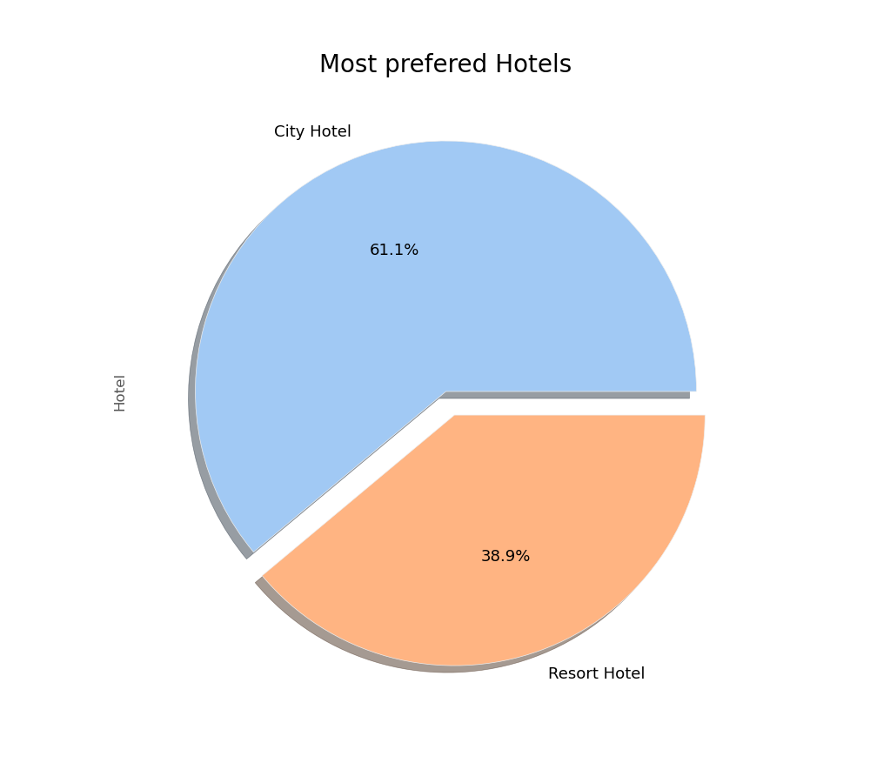
Top Most Preferred Hotel
Insights found
From the chart, we got to know that City Hotel is most preferred hotel by the guests. Thus City Hotel has maximum bookings. 61.1% guests are preferred City Hotel, while only 38.9% guests have shown interest in Resort Hotel.

Slide 12
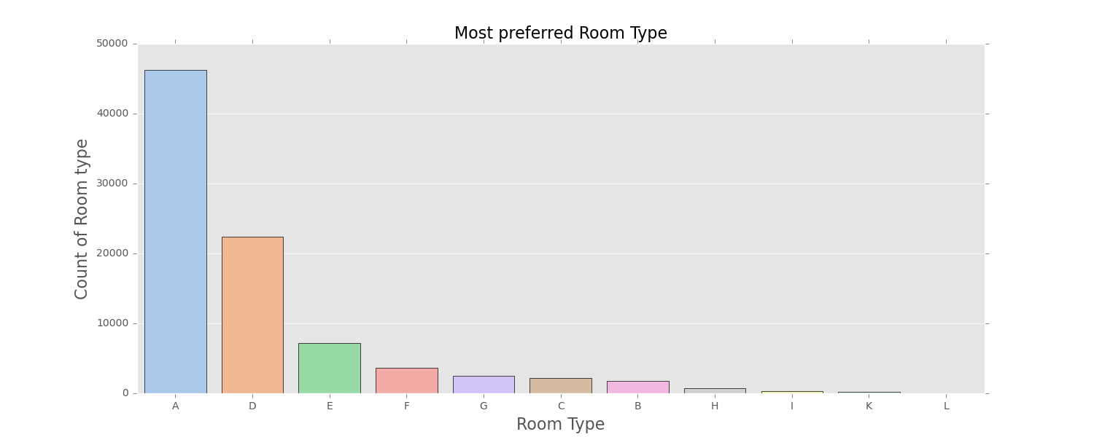
Most Preferred Hotel Rooms
It is found that the most preferred Room type is 'A'. So, majority of the guests have shown interest in this room type.
There are positive impacts because 'A', 'D', 'E' is more preferred by guest due to better services offered in room type.

Slide 13
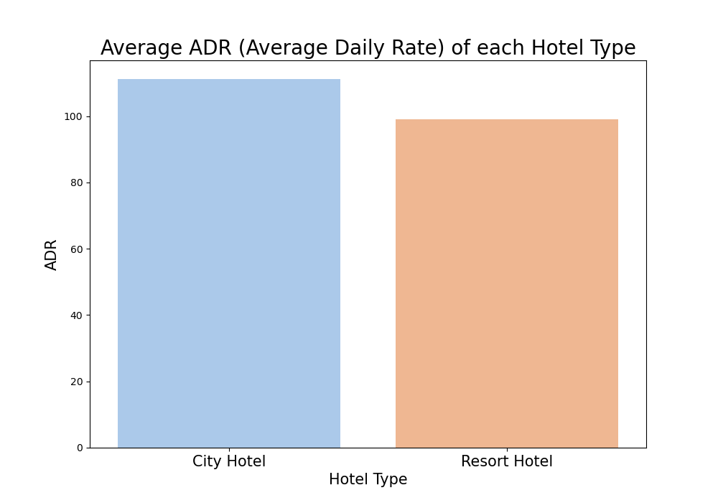
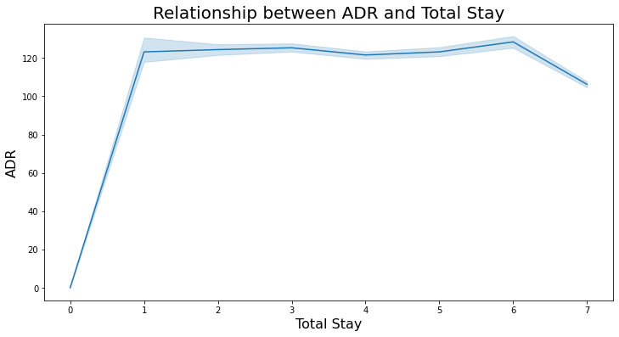
Average Daily Rate
City Hotels are generating more revenues than the Resort Hotels, because City hotel has the highest ADR. More the ADR, more will be the revenue.
From the line chart, we have found that as the total stay increases the ADR is also getting high. So, ADR is directly proportional to total stay.

Slide 14
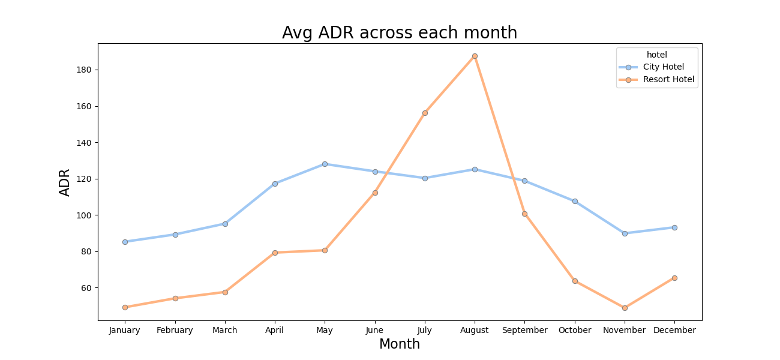
Average Daily Rate
ADR across months
For Resort Hotel, ADR is high in the months of June, July, August as compared to City Hotels. The reason may be that customers/people want to spent their summer vacation in Resort Hotels.

Slide 15
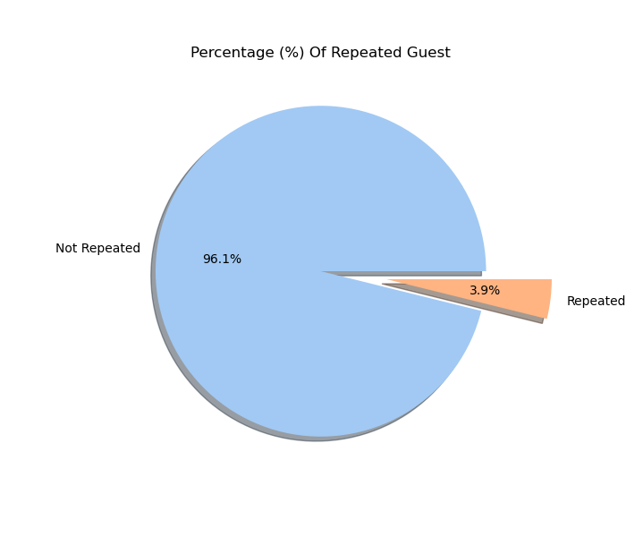
Repeated Vs Non-Repeated Guests
Insights found
The pie chart show the percentage of repeated guests or not (where 0 is not repeated guest and 1 is repeated guest)
Repeated guests are very few which is only 3.9% while 96.1% guests are not returning to the same hotel.
The guests management should take feedbacks from guests and try to improve the services.

Slide 16
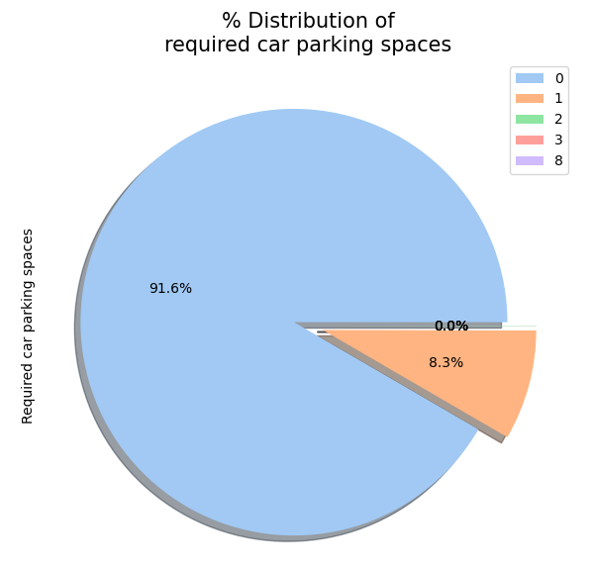
Requirement of Car Parking Space
Insights found
This chart shows that 91.6% guests did not required the parking space. Only 8.3% guests required the parking space.
The demand for car parking area is less. It can be said that hotels need to work less on car parking spaces as only 1 car parking space was required by 8.3% of guests.

Slide 17
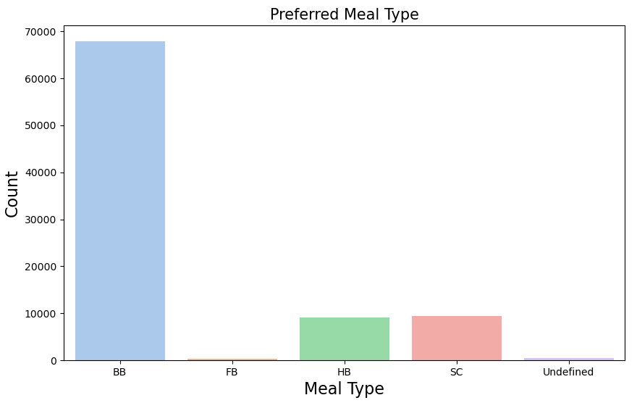
Most Preferred Meal
Insights found
The most preferred meal type by the guests is BB (Bed and Breakfast) while HB (Half Board) and SC (Self Catering) are equally preferred.

Slide 18
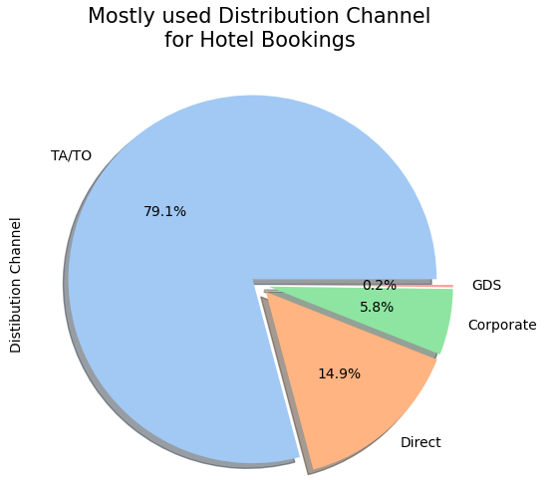
Maximum used Distribution Channel
Insights found
'TA/TO' has been mostly (79.1%) used for booking hotels. Direct market segment of 14.9%, Corporates market segment of 5.8%, GDS market segment of only 0.2% and rest unidentified are 0%.

Slide 19
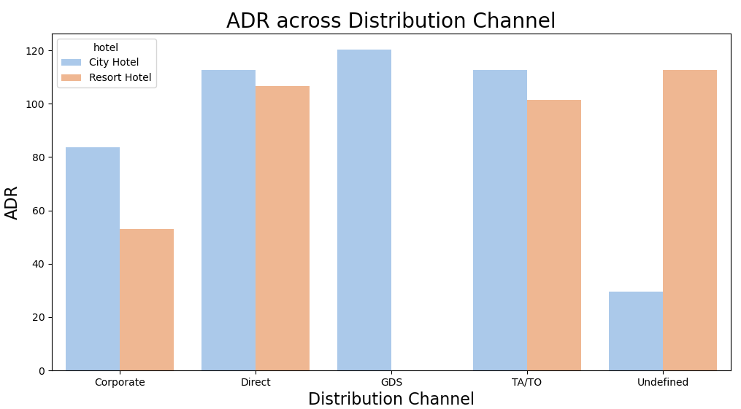
Distribution Channel Vs ADR
'Direct' and 'TA/TO' have almost equally contribution in ADR in both type of hotels. While, GDS has highly contributed in ADR in 'City Hotel' type. GDS needs to increase Resort Hotel bookings.

Slide 20
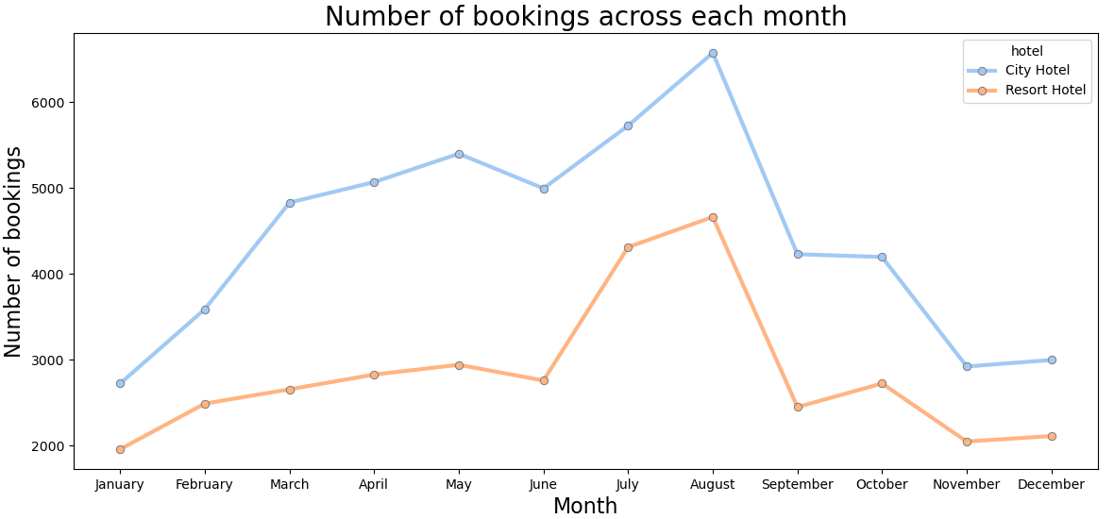
Top Booking Months
From this graph, we can say that July and August months had the most Bookings. As, July and August generally surrounds in and near the summer vacation.
Hotels should be well prepared for the month of July and August as maximum bookings takes place for this month.

Slide 21
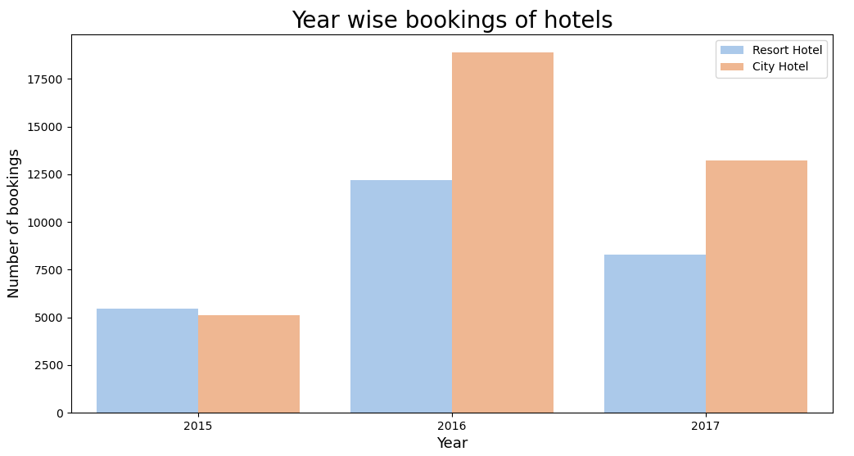
Top Booking Year
It can be summarised that in the year 2016 both the hotel saw a massive increase in their bookings and by far the year 2016 is the year of the highest bookings of both hotel. In 2016 and 2017 the City hotel is having the highest number of bookings but in 2015 the Resort hotel is having the highest number of bookings.

Slide 22
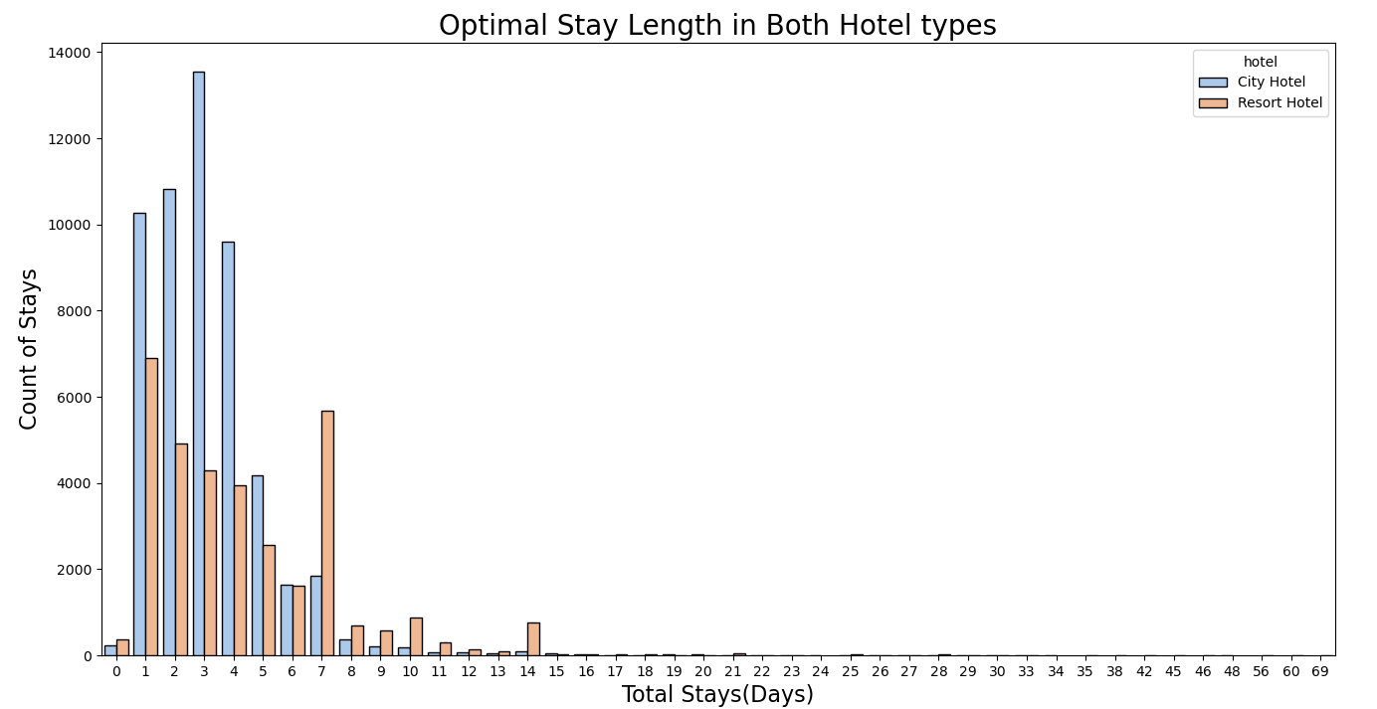
Optimal Stay Length
We have found that the Optimal stay in both the type hotel is less than 7 days. So, after that staying numbers have declined drastically.
Customers usually prefers a one week stay in a hotel. So, hotels need to work efficiently in these seven days so that customers would return to the same hotel again.

Slide 23
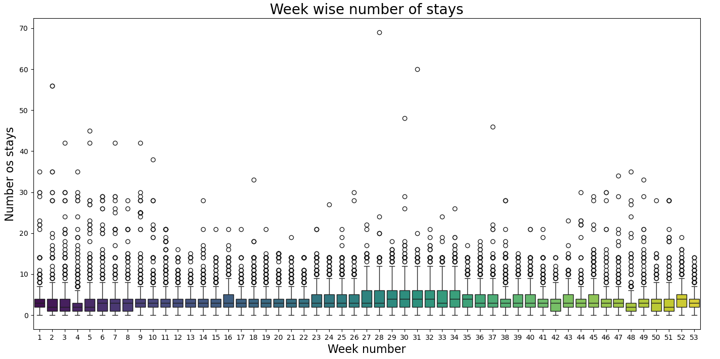
Optimal Stay Length
Week Wise Number of Stay
From the week 28 to 31, it has shown the highest days of stay whereas from the week 1 to 11 has shown a very steady trend in the number of stays and also the week 18 to 22 has shown the least number of stays by the visitors in aggregate of all 3 years 2015, 2016 and 2017.

Slide 24
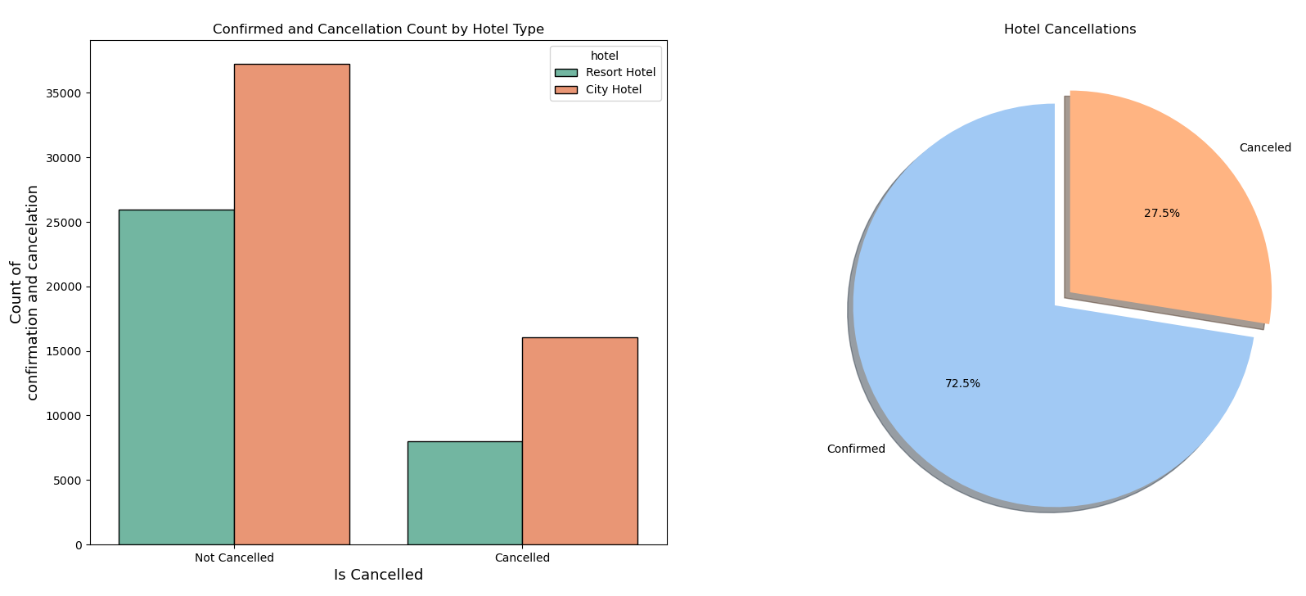
Confirmation Vs Cancellation
More than 1/4th of the overall bookings i.e. approx. 27.5% of the tickets was got canceled.
We can clearly deduce from the 2nd graph that the City hotel is having greater number of bookings as compared to Resort hotel. But, the cancelation percentage is also high of the City Hotel.

Slide 25
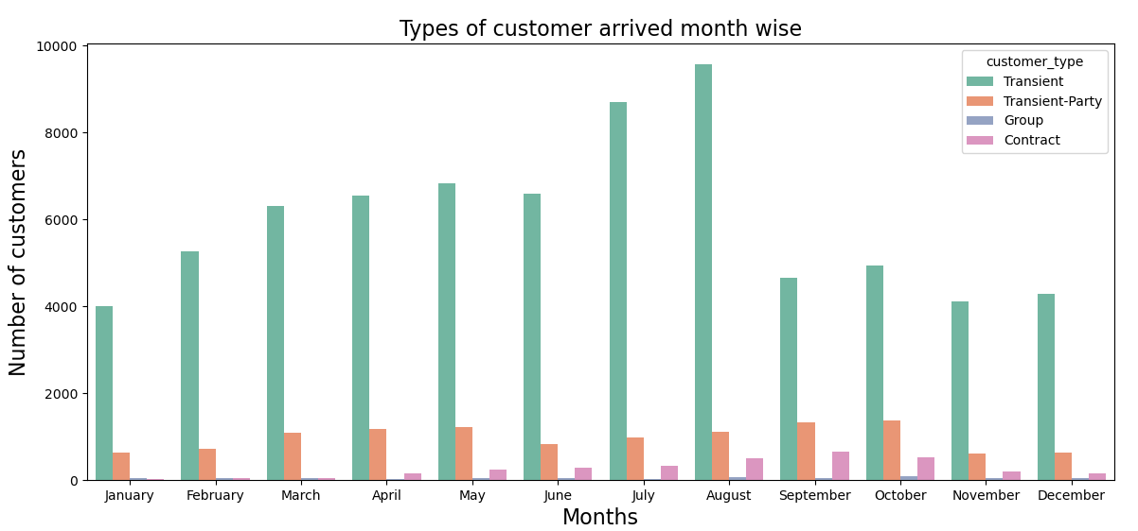
Mostly Arrived Customers/ Visitors
It can be summarized that the Transient type of customers visit the most whereas the visitors who are in group comes in the category of least visitors.

Slide 26
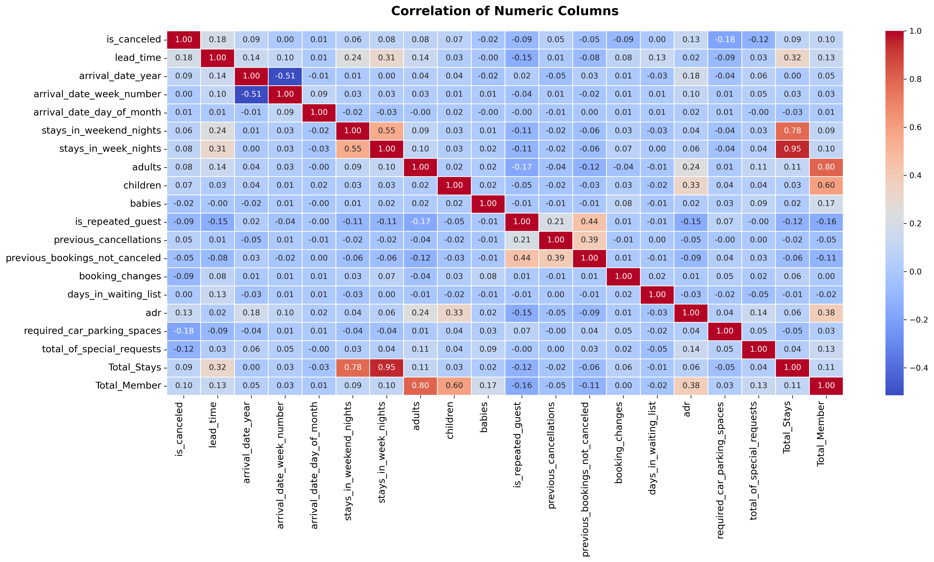
Overall Stats (Co-relation Heatmap)

Slide 27
Insight Found from the Heat Map
Highly correlated:
'stays_in_weekend_nights' and 'stays_in_week_nights': A strong positive correlation of 0.55 suggests that longer weekend stays are often associated with longer weeknight stays.
'total_of_special_requests' and 'Total_Stays': A positive correlation of 0.78 indicates that guests making more special requests tend to stay longer.
'Total_Stays' and 'Total_Member': A positive correlation of 0.95 suggests that the number of stays is highly related to the number of total members in the group.
Moderately correlated:
'lead_time' and 'stays_in_week_nights': A positive correlation of 0.31 indicates that bookings made further in advance are more likely to involve longer weeknight stays.
'lead_time' and 'Total_Stays': A positive correlation of 0.32 suggests that longer lead times are associated with more stays overall.
'days_in_waiting_list' and 'Total_Stays': A positive correlation of 0.38 implies that a longer waiting list might indicate a longer stay.
Weakly correlated:
'is_canceled' and 'lead_time': A positive correlation of 0.18, suggesting a slight tendency for cancellations to occur with longer lead times.
'adults' and 'Total_Stays': A positive correlation of 0.11, indicating a slight tendency for more adults in a group to be associated with a longer stay.

Slide 28
Conclusion
City Hotels Are Most Preferred: City hotels are the busiest compared to resort hotels, making them the most preferred hotel type by guests.
Higher Revenue for City Hotels: The average ADR (Average Daily Rate) for city hotels is higher than that of resort hotels, indicating that city hotels generate more revenue.
Total Stay and ADR Relationship: The total stay of guests is directly proportional to ADR. Longer stays result in higher ADR and increased revenue.
Low Guest Retention: Only 3.9% of guests are repeat customers, while 96.1% are new guests, indicating a low retention rate.
Low Demand for Car Parking: Only 8.4% of guests require car parking spaces. This shows that limited parking availability does not significantly impact the business.
Preferred Meal Type: Among meal types, BB (Bed & Breakfast) is the most preferred by guests, indicating their inclination towards simple and convenient meal plans

Slide 29
Conclusion
Distribution Channel Contributions to ADR:
Direct bookings and TA/TO (Travel Agents/Tour Operators) have nearly equal contributions to ADR for both city and resort hotels.
GDS (Global Distribution System) significantly contributes to ADR in city hotels.
Optimal Stay Length: Guests typically stay for less than 7 days in both city and resort hotels. Stays longer than a week show a steep decline in frequency.
Popular Months for Bookings: The majority of bookings occur in July and August, making these the busiest months for hotels.
Most Used Distribution Channel: The most utilized distribution channel is TA/TO, accounting for 79.1% of total bookings.
Seasonal ADR Trends: For resort hotels, the ADR peaks during June, July, and August, while city hotels exhibit relatively stable ADR throughout the year.
High Cancellation Rate: Approximately 27.5% of all bookings are canceled, indicating a significant number of lost opportunities.
Most Preferred Room Type: Room type A is the most preferred by guests, showing the highest demand among all room types.

Slide 30
Thank You

